Slide 1
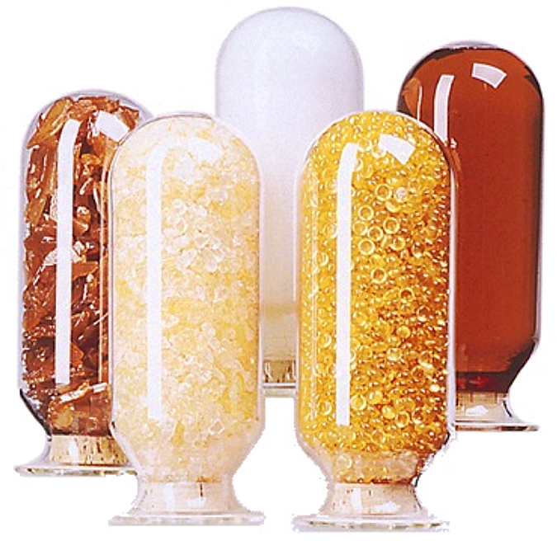
Phenolic Resin
M.Sc.- First Semester -2023-2024

Slide 2
Introduction
Phenolic resins are obtained by the reaction of phenols with aldehydes. Both parent compounds, phenol and formaldehyde, are by far the most important components in commercial phenolic resin production
Phenolic resins are the oldest commercially manufactured synthetic polymer. They were first 'invented' by Leo Hendrik Baekeland in 1907. He was the one to develop an economical method to convert these resins to moldable formulations which were transformed by heat and pressure into hard and resistant molded parts

Slide 3
Phenols
Phenols are a family of aromatic compounds with the hydroxyl group bonded directly to the aromatic nucleus. They differ from alcohols in that they behave like weak acids and dissolve readily in aqueous sodium hydroxide, but are insoluble in aqueous sodium carbonate. Phenols are colorless solids with the exception of some liquid alkylphenols. Selected physical properties of phenols are listed in below Table

Slide 4
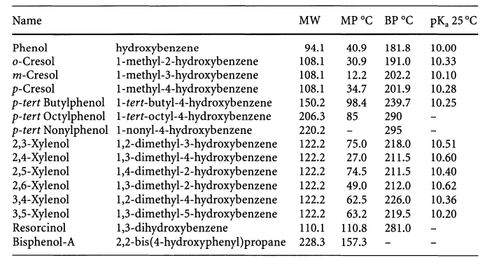

Slide 5
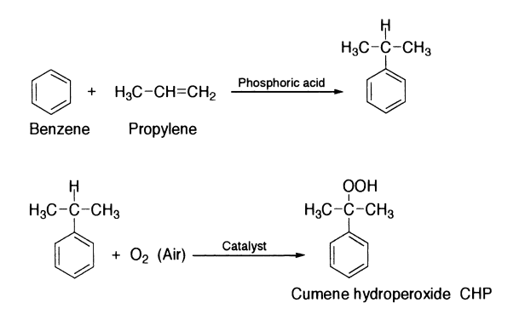
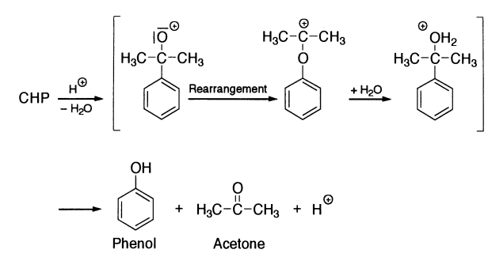
Phenol Production Processes
In the commercial process, cumene is oxidized with air to CHP {95% yield) which is concentrated and cleaved in presence of an acidic catalyst at high efficiency (99%) to phenol and acetone

Slide 6
Toluene Oxidation Process
Other Synthesis Processes Several other synthesis processes (listed below) have no commercial importance:
Chlorination of benzene and alkaline hydrolysis of chlorobenzene
Chlorination of benzene and steam hydrolysis of chlorobenzene ( Rasehig process, Raschig-Hooker and Gulf oxychlorination process)
Sulfonation of benzene and benzenesulfonate decomposition in molten sodium hydroxide to sodium phenolate (A. Wurtz and A. Kekule)
Cyclohexene conversion to cyclohexanol-cyclohexanone mixtures followed by dehydrogenation to phenol (Mitsui Petrochemical1989)

Slide 7
Aldehydes
Formaldehyde is practically the only carbonyl component used in the synthesis of industrial phenolic resins. Special resins are made with other aldehydes, e. g., acetaldehyde, butyraldehyde, furfural, glyoxal, or benzaldehyde, but these have not achieved much commercial importance. Ketones are also rarely used. Physical properties of some aldehydes are compiled in Table below

Slide 8
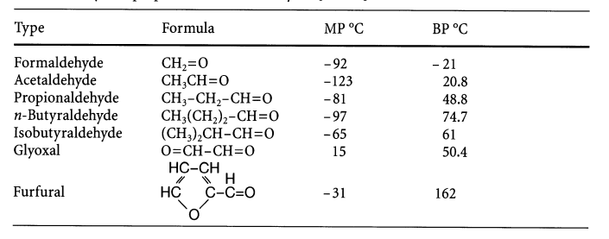
Formaldehyde, the first of the series of aliphatic aldehydes, was discovered in 1859 by Butlerov and has been manufactured on a commercial scale since the beginning of the twentieth century. Because of its variety of chemical reactions and relatively low cost (basically reflecting the cost of methanol) it has become one of the most important industrial chemicals.

Slide 9
Hexamethylenetetramine
Hexamethylenetetramine, HMTA, is by far the most important compound to cure Novolac type of resins. It is prepared from formaldehyde and ammonia according to Eq. below
In reverse, HMTA decomposes at elevated temperatures. In aqueous solution, HMTA is easily hydrolyzed to amino methylated compounds and is often used as catalyst in the resole synthesis instead of ammonia. HMTA is quite soluble in water, but less soluble in methanol or ethanol. The aqueous solution exhibits a weak alkaline action with a pH in the range 7-10. In powder form, HMTA is prone to dust explosions. It is ratedas a severe explosion hazard.

Slide 10
Phenolic resins are obtained by step growth polymerization of
difunctional monomers (aldehydes) with monomers of functionality greater than 2 (Phenol, substituted Phenols or combination of phenols).
Key factors in the design of the desired phenolic resin are:
- Molar ratio of F to P
Mode of catalysis: Acid, base, metal salt, enzyme.
Note: Reaction of phenolic compounds with aldehydes under acidic or basic catalyst are exothermic , so side reaction due to exothermic need to be avoided
Basic Chemistry

Slide 11
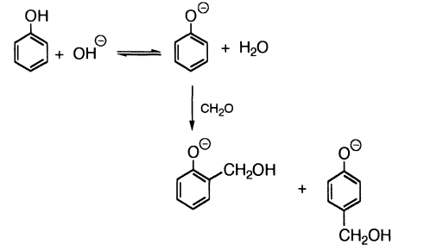
Resole
The simplest phenolic component that can cure into a phenolic resin is o- or p-methylol phenol. The reaction of P with Funder basic conditions is initially the addition of F to phenolate leading to o- and p-methylol phenol.

Slide 12
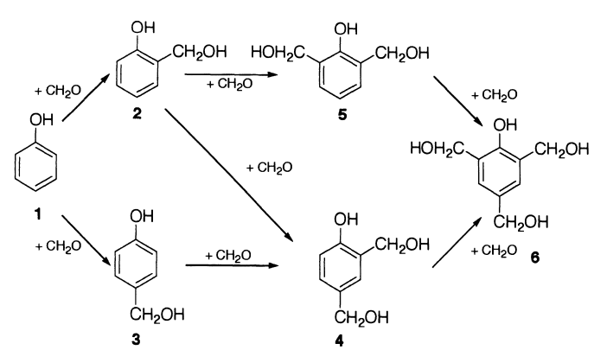
Resole
Besides monomethylol phenols, some dimethylol phenols, and trimethylol phenol are formed. It is commonly referred to as the Lederer-Manasse reaction.

Slide 13
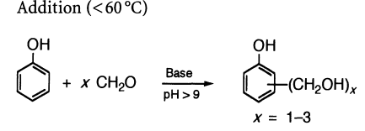
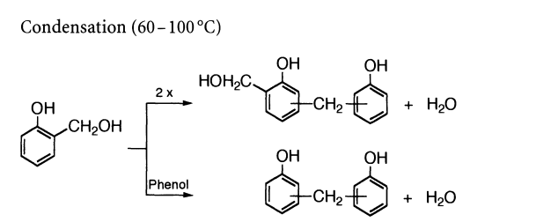
Resole
at low temperatures ( 60 °C} only addition of formaldehyde to phenol occurs. In a temperature range above 60 °C, condensation reactions of methylol phenols with phenol and/or methylol phenols occur and lead to prepolymer or the desired resole resin

Slide 14
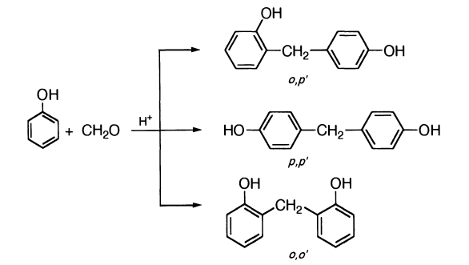
Novolac
the simplest Novolac, is prepared by conducting the reaction of P and F with a large excess of phenol under acidic conditions. A mixture of isomers is obtained: o,p' isomer predominates, followed by p,p' and o,o'

Slide 15
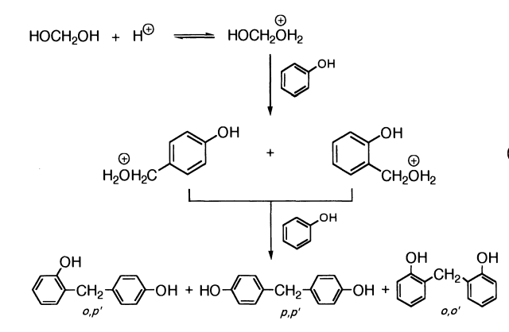
Novolac
The mechanism of formation involves initial protonation of methylene glycol which reacts with phenol at the ortho and para positions
In aqueous solution, formaldehyde exists in equilibrium with methylene glycol.

Slide 16
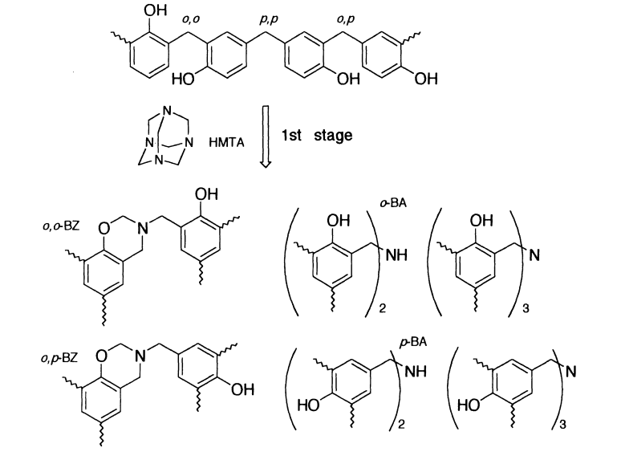
Novolac

Slide 17
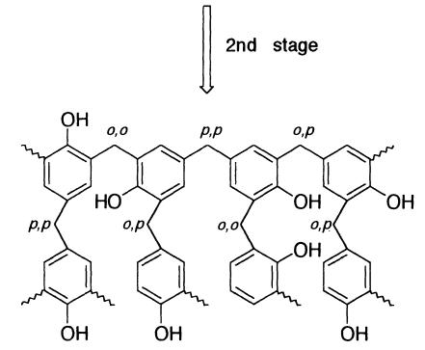

Slide 18
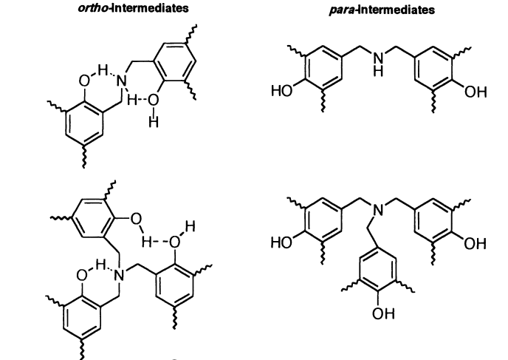
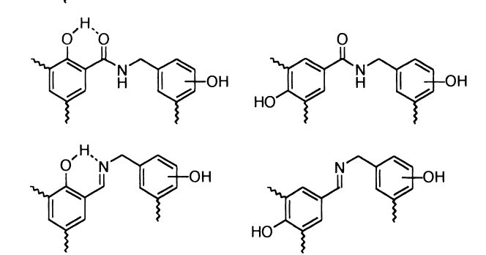

Slide 19
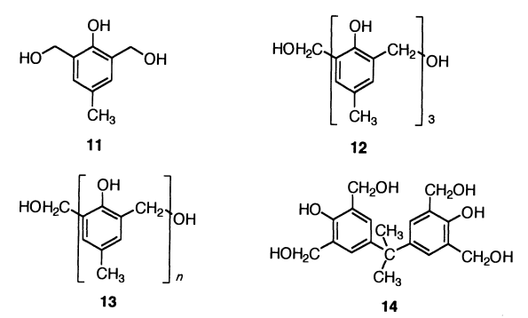
Non-Hexa Cure
It was mentioned earlier that non-hexa curing methods consist of the use of hydroxymethyl derivatives of phenol, bisoxazolines, bisbenzoxazines, and solid resole.
Besides bismethylol cresol (11) other bismethylol compounds based on cresol trimer (12), cresol Novolac (13) and Bisphenol A tetramethylol (14) were evaluated:

Slide 20
Novolac because it dose not contain reactive groups in their structure , so the curing chemistry must be needed to curing agents like formaline and hexamethylene tetra amine (hexamine )
Heating is very important factor for complete the curing.
?

Slide 21
Two prepolymers types are obtained depending on pH
Type of Phenolic Resin | Novolac Resin | Resol Resin
Type of Reaction | Electrophelic Mechanism | Nucleophilic Mechanism
Medium of Reaction ( pH) | Acidic Med. ( 1-5 ) | Basic Med. ( > 7)
Molar Ratio ( P:F ) | 1: 0.8 | 1:2- 1:4
Type or behavior of Polymer | Linear or Slightly Branch | Branch
Characteristic Properties | Low MWT, Soluble | Low MWT , non Soluble

Slide 22
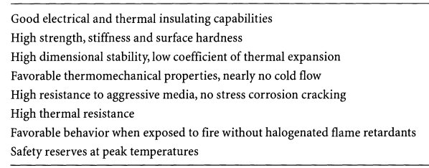
Applications of Phenolic Resins

Slide 23
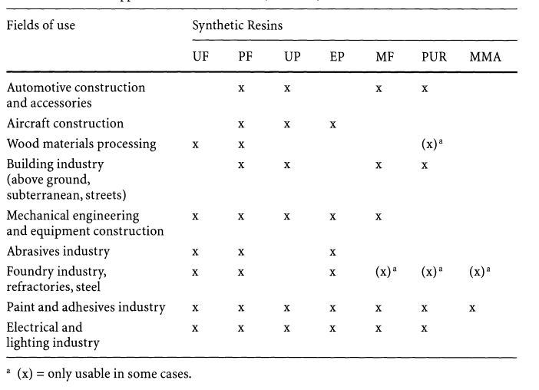
Applications of Phenolic Resins
UP = unsaturated polyester, PF = phenolic, EP = epoxy, PUR = polyurethane, MF = melamine, UF = urea resin, MMA =methylmethaacrylate)

Slide 24
Thank You

